Slide 1
Guide to Dimensional Measurement Equipment
Capability Charts
Version 3.0 October 2018

Slide 2
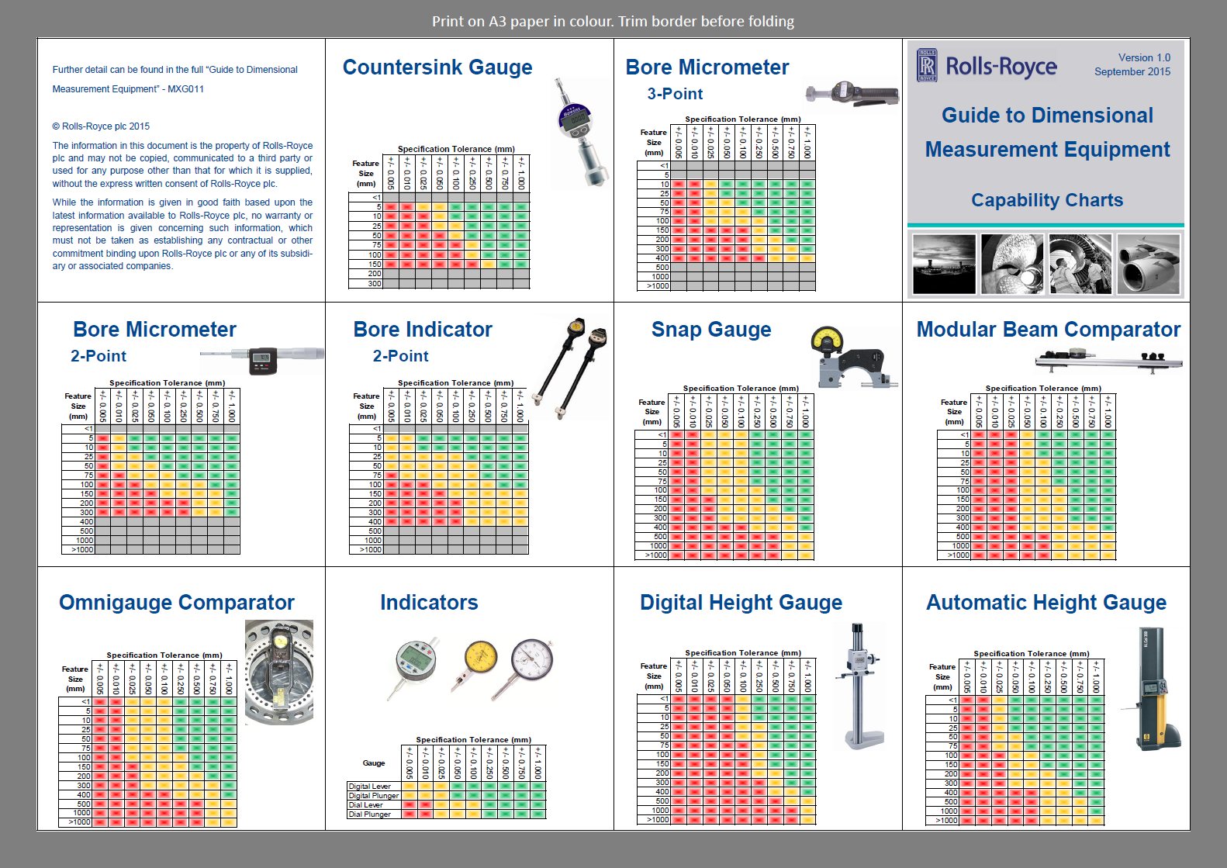

Slide 3
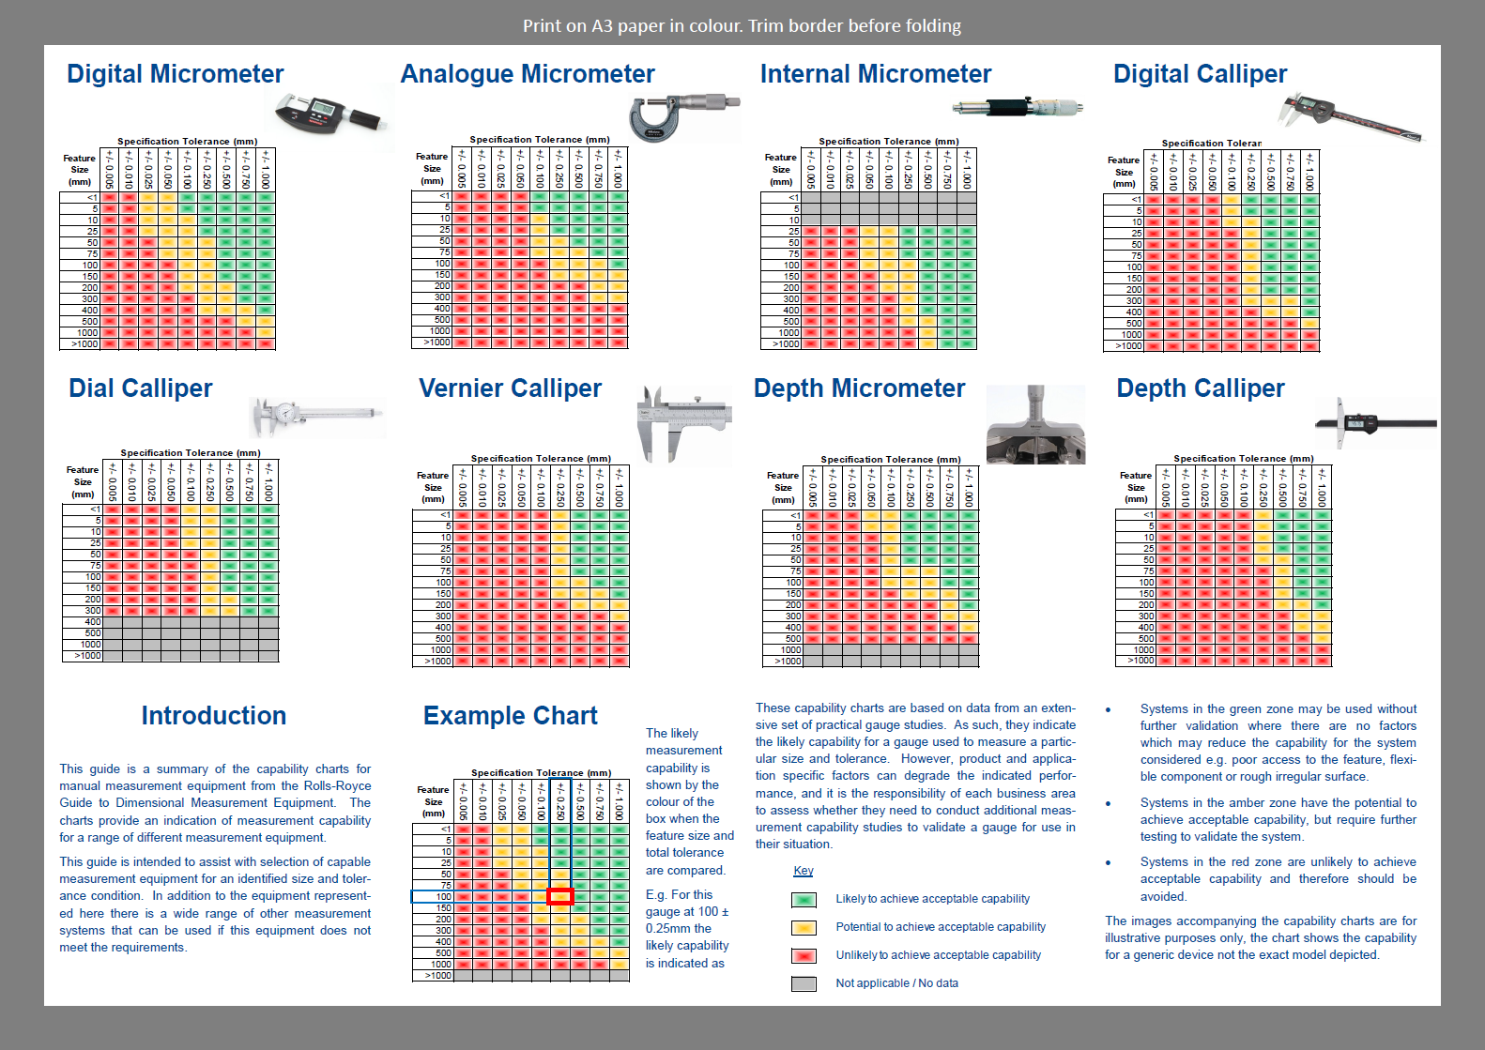

Slide 4
Document Control
Applicability: Global
Title: Guide to Dimensional Measurement Equipment – Capability Charts
Author: John Brownell
Document Owner: Andrew Wall
Version Number: 3.0
Issue Date and Change History: October 2018

